Slide 1
GRAPH DATA STRUCTURES

Slide 2
Spanning Trees
A Spanning Tree of a graph is a subset of Graph G, which has all the vertices covered with minimum possible number of edges. Hence, a spanning tree does not have cycles and it cannot be disconnected.
By this definition, we can draw a conclusion that every connected and undirected Graph G has at least one spanning tree. A disconnected graph does not have any spanning tree, as it cannot be spanned to all its vertices.

Slide 3
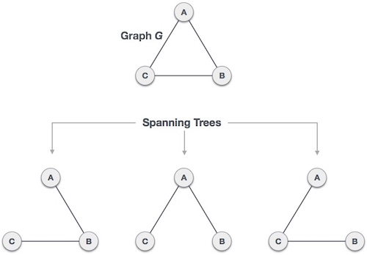
Spanning Trees

Slide 4
Spanning Trees
A connected undirected graph can have maximum n^{n-2} number of spanning trees, where n is the number of nodes. In the above addressed example, 3³⁻² = 3 spanning trees are possible.

Slide 5
General Properties of Spanning Trees
A connected graph G can have more than one spanning tree.
All possible spanning trees of graph G, have the same number of edges and vertices.
The spanning tree does not have any cycle (loops).
The spanning tree contains v-1 edges.
Removing one edge from the spanning tree will make the graph disconnected, i.e. the spanning tree is minimally connected.
Adding one edge to the spanning tree will create a circuit or loop, i.e. the spanning tree is maximally acyclic.

Slide 6
Minimum Spanning Trees
Suppose you have a connected undirected graph with a weight (or cost) associated with each edge
The cost of a spanning tree would be the sum of the costs of its edges
A minimum spanning tree is a spanning tree that has the lowest cost
16
16
16
A
A
B
B
A
B
6
21
6
6
21
11
11
11
5
5
19
5
19
F
F
C
C
F
C
14
33
14
33
10
10
18
E
18
18
E
D
D
E
D
A connected, undirected graph
A connected, undirected graph
A minimum-cost spanning tree

Slide 7
Real Life Application of a MST
A cable TV company is laying cable in a new city. If it is constrained to bury the cable only along certain paths, then there would be a graph representing which points are connected by those paths. Some of those paths might be more expensive, because they are longer, or require the cable to be buried deeper; these paths would be represented by edges with larger weights. A minimum spanning tree would be the network with the lowest total cost.

Slide 8
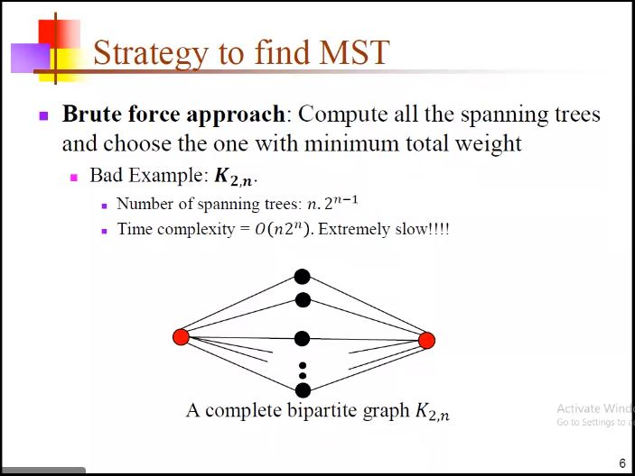

Slide 9


Slide 10
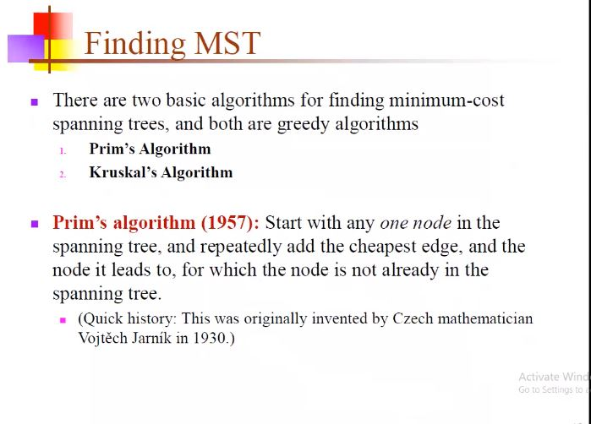

Slide 11
Minimum Spanning Tree
A Minimum Spanning Tree is a spanning tree in which the total weight of the edges is guaranteed to be the minimum of all possible spanning trees of the graph.
Minimum Spanning Trees Algorithms
Kruskal’s Algorithm
Prim’s Algorithm

Slide 12
Algorithm Characteristics
Both Prim’s and Kruskal’s Algorithms work with connected, weighted and undirected graphs.
Both are greedy algorithms that produce optimal solutions.

Slide 13
Kruskal’s Algorithm
Sort all the edges in non-decreasing order of their weights.
2. Pick the minimum weighted edge. Check if it forms a cycle with the spanning tree formed so far. If not, include the edge. Else discard it.
3. Repeat step 2 until there are (V-1) edges in the spanning tree.

Slide 14
EXAMPLE
Consider an undirected, weighted graph
F
3
C
10
A
4
3
8
4
5
B
6
D
4
4
H
2
1
3
G
E
3

Slide 15
Sort the edges by increasing edge weight
F
3
C
edge | w
(D,E) | 1
(D,G) | 2
(E,G) | 3
(C,D) | 3
(G,H) | 3
(C,F) | 3
(B,C) | 4
edge | w
(B,E) | 4
(B,F) | 4
(B,H) | 4
(A,H) | 5
(D,F) | 6
(A,B) | 8
(A,F) | 10
10
A
4
3
8
4
5
B
6
D
4
4
H
2
1
3
G
E
3

Slide 16
Select first V–1 edges which do not generate a cycle
F
3
C
edge | d_{v}
(D,E) | 1 | √
(D,G) | 2
(E,G) | 3
(C,D) | 3
(G,H) | 3
(C,F) | 3
(B,C) | 4
edge | d_{v}
(B,E) | 4
(B,F) | 4
(B,H) | 4
(A,H) | 5
(D,F) | 6
(A,B) | 8
(A,F) | 10
10
A
4
3
8
4
5
B
6
D
4
4
H
2
1
3
G
E
3

Slide 17
Select first V–1 edges which do not generate a cycle
F
3
C
edge | d_{v}
(D,E) | 1 | √
(D,G) | 2 | √
(E,G) | 3
(C,D) | 3
(G,H) | 3
(C,F) | 3
(B,C) | 4
edge | d_{v}
(B,E) | 4
(B,F) | 4
(B,H) | 4
(A,H) | 5
(D,F) | 6
(A,B) | 8
(A,F) | 10
10
A
4
3
8
4
5
B
6
D
4
4
H
2
1
3
G
E
3

Slide 18
Select first V–1 edges which do not generate a cycle
F
3
C
edge | d_{v}
(D,E) | 1 | √
(D,G) | 2 | √
(E,G) | 3 | χ
(C,D) | 3
(G,H) | 3
(C,F) | 3
(B,C) | 4
edge | d_{v}
(B,E) | 4
(B,F) | 4
(B,H) | 4
(A,H) | 5
(D,F) | 6
(A,B) | 8
(A,F) | 10
10
A
4
3
8
4
5
B
6
D
4
4
H
2
1
3
G
E
3
Accepting edge (E,G) would create a cycle

Slide 19
Select first V–1 edges which do not generate a cycle
F
3
C
edge | d_{v}
(D,E) | 1 | √
(D,G) | 2 | √
(E,G) | 3 | χ
(C,D) | 3 | √
(G,H) | 3
(C,F) | 3
(B,C) | 4
edge | d_{v}
(B,E) | 4
(B,F) | 4
(B,H) | 4
(A,H) | 5
(D,F) | 6
(A,B) | 8
(A,F) | 10
10
A
4
3
8
4
5
B
6
D
4
4
H
2
1
3
G
E
3

Slide 20
Select first V–1 edges which do not generate a cycle
F
3
C
edge | d_{v}
(D,E) | 1 | √
(D,G) | 2 | √
(E,G) | 3 | χ
(C,D) | 3 | √
(G,H) | 3 | √
(C,F) | 3
(B,C) | 4
edge | d_{v}
(B,E) | 4
(B,F) | 4
(B,H) | 4
(A,H) | 5
(D,F) | 6
(A,B) | 8
(A,F) | 10
10
A
4
3
8
4
5
B
6
D
4
4
H
2
1
3
G
E
3

Slide 21
Select first V–1 edges which do not generate a cycle
F
3
C
edge | d_{v}
(D,E) | 1 | √
(D,G) | 2 | √
(E,G) | 3 | χ
(C,D) | 3 | √
(G,H) | 3 | √
(C,F) | 3 | √
(B,C) | 4
edge | d_{v}
(B,E) | 4
(B,F) | 4
(B,H) | 4
(A,H) | 5
(D,F) | 6
(A,B) | 8
(A,F) | 10
10
A
4
3
8
4
5
B
6
D
4
4
H
2
1
3
G
E
3

Slide 22
Select first V–1 edges which do not generate a cycle
F
3
C
edge | d_{v}
(D,E) | 1 | √
(D,G) | 2 | √
(E,G) | 3 | χ
(C,D) | 3 | √
(G,H) | 3 | √
(C,F) | 3 | √
(B,C) | 4 | √
edge | d_{v}
(B,E) | 4
(B,F) | 4
(B,H) | 4
(A,H) | 5
(D,F) | 6
(A,B) | 8
(A,F) | 10
10
A
4
3
8
4
5
B
6
D
4
4
H
2
1
3
G
E
3

Slide 23
Select first V–1 edges which do not generate a cycle
F
3
C
edge | d_{v}
(D,E) | 1 | √
(D,G) | 2 | √
(E,G) | 3 | χ
(C,D) | 3 | √
(G,H) | 3 | √
(C,F) | 3 | √
(B,C) | 4 | √
edge | d_{v}
(B,E) | 4 | χ
(B,F) | 4
(B,H) | 4
(A,H) | 5
(D,F) | 6
(A,B) | 8
(A,F) | 10
10
A
4
3
8
4
5
B
6
D
4
4
H
2
1
3
G
E
3

Slide 24
Select first V–1 edges which do not generate a cycle
F
3
C
edge | d_{v}
(D,E) | 1 | √
(D,G) | 2 | √
(E,G) | 3 | χ
(C,D) | 3 | √
(G,H) | 3 | √
(C,F) | 3 | √
(B,C) | 4 | √
edge | d_{v}
(B,E) | 4 | χ
(B,F) | 4 | χ
(B,H) | 4
(A,H) | 5
(D,F) | 6
(A,B) | 8
(A,F) | 10
10
A
4
3
8
4
5
B
6
D
4
4
H
2
1
3
G
E
3

Slide 25
Select first V–1 edges which do not generate a cycle
F
3
C
edge | d_{v}
(D,E) | 1 | √
(D,G) | 2 | √
(E,G) | 3 | χ
(C,D) | 3 | √
(G,H) | 3 | √
(C,F) | 3 | √
(B,C) | 4 | √
edge | d_{v}
(B,E) | 4 | χ
(B,F) | 4 | χ
(B,H) | 4 | χ
(A,H) | 5
(D,F) | 6
(A,B) | 8
(A,F) | 10
10
A
4
3
8
4
5
B
6
D
4
4
H
2
1
3
G
E
3

Slide 26
Select first V–1 edges which do not generate a cycle
F
3
C
edge | d_{v}
(D,E) | 1 | √
(D,G) | 2 | √
(E,G) | 3 | χ
(C,D) | 3 | √
(G,H) | 3 | √
(C,F) | 3 | √
(B,C) | 4 | √
edge | d_{v}
(B,E) | 4 | χ
(B,F) | 4 | χ
(B,H) | 4 | χ
(A,H) | 5 | √
(D,F) | 6
(A,B) | 8
(A,F) | 10
10
A
4
3
8
4
5
B
6
D
4
4
H
2
1
3
G
E
3

Slide 27
Select first V–1 edges which do not generate a cycle
F
3
C
edge | d_{v}
(D,E) | 1 | √
(D,G) | 2 | √
(E,G) | 3 | χ
(C,D) | 3 | √
(G,H) | 3 | √
(C,F) | 3 | √
(B,C) | 4 | √
edge | d_{v}
(B,E) | 4 | χ
(B,F) | 4 | χ
(B,H) | 4 | χ
(A,H) | 5 | √
(D,F) | 6
(A,B) | 8
(A,F) | 10
A
3
4
5
B
D
H
2
1
}
3
G
E
not
considered

Slide 28
Kruskal's algorithm
MST_KRUSKAL(G,w)
1 A:={}
2 for each vertex v in V[G]
3 do MAKE_SET(v)
4 sort the edges of E by non decreasing weight w
for each edge (u,v) in E, in order by non decreasing weight
6 do if FIND_SET(u) != FIND_SET(v)
7 then A:=A∪{(u,v)}
8 UNION(u,v)
return A

Slide 29
Complexity of Kruskal's algorithm
Space Complexity = O(E + V)
Time Complexity = O(E log (E) + E)
Time to sort the edges in
Non-Decreasing order

Slide 30
Prim’s Algorithm
1. Create a set mstSet that keeps track of vertices already included in MST.
2. Assign a key value to all vertices in the input graph. Initialize all key values as ∞. Assign key value as 0 for the first vertex so that it is picked first.
3. While mstSet doesn’t include all vertices.
(a) Pick a vertex u which is not there in mstSet and has
minimum key value.
(b) Include u to mstSet.
(c) Update key value of all adjacent vertices of u. To update the
key values, iterate through all adjacent vertices. For every adjacent vertex v, if weight of edge u-v is less
than the previous key value of v, update the key value as
weight of u-v.

Slide 31
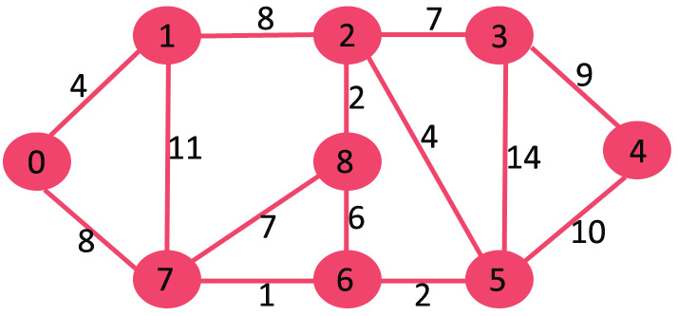
EXAMPLE

Slide 32
Some points to note
Both algorithms will always give solutions with the same length.
They will usually select edges in a different order – you must show this in your workings.
Occasionally they will use different edges – this may happen when you have to choose between edges with the same length. In this case there is more than one minimum connector for the network.

